Slide 1
MQP Progress 9/7/21
Ryan Astor, Kyle Costello, Josh DeOliveira, Alek Lewis
Notes:
Ryan

Slide 2
Accomplishments
Watched Anaconda tutorial (Kyle, Ryan, Alek)
Installed Anaconda (Kyle, Ryan, Alek)
Installed Pytorch (Kyle, Ryan, Alek)
Done Pytorch Blitz (Kyle, Ryan, Alek)
Installed Jupyter Notebook (Kyle, Ryan, Alek)
Read original GAN paper (Kyle, Ryan, Alek, Josh)
Documented a simple GAN implementation + training demo (Josh)
Notes:
Ryan

Slide 3
GAN Papers
Notes:
Ryan

Slide 4
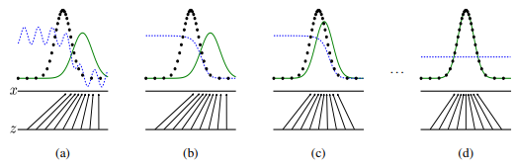
Original GAN Paper
GANs consist of a Generator (G) and a Discriminator (D)
G attempts to map random noise to a real distribution
D attempts to discriminate between a real distribution and G’s output
So long as D never overfits, G should iteratively converge towards the real distribution
Goodfellow, Ian et. al. “Generative Adversarial Nets”
Notes:
Ryan

Slide 5
Simple GANs
Simple GAN strengths
Should work with most possible functions
Works much better than non-GAN generative models
Markov chains are never needed
Simple GAN weaknesses
Training is difficult
The generator is unable to create anything which exists outside of the known data
Notes:
Kyle
cannot train either model too much without training the other, or it’ll cause overfitting
if you only have pictures of wolves on snow, you can’t generate wolves on grass!

Slide 6
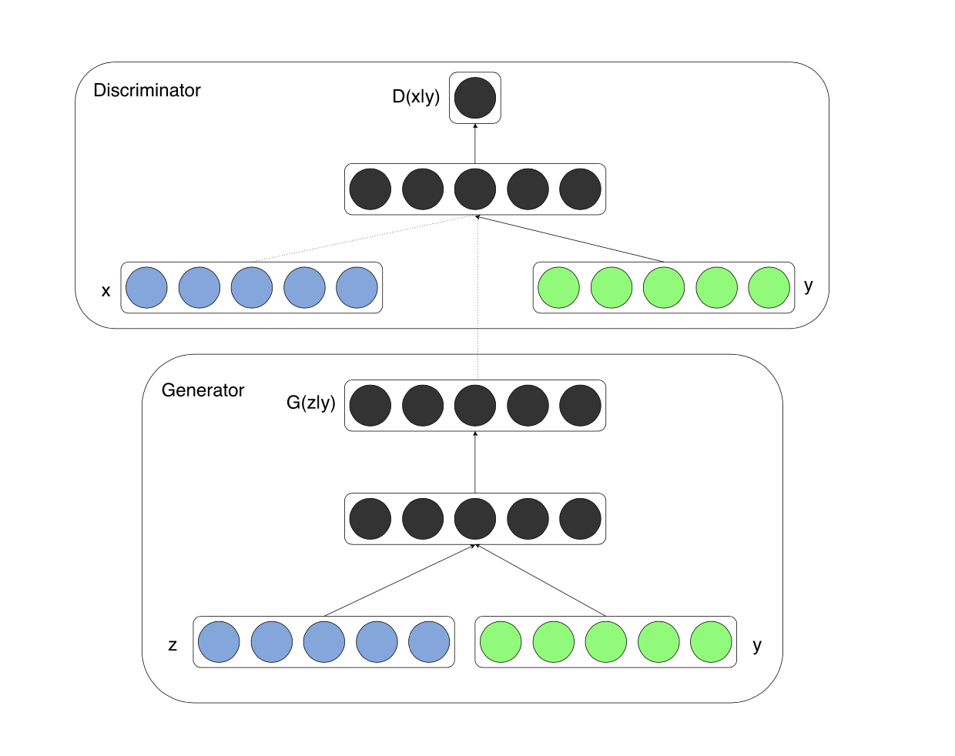
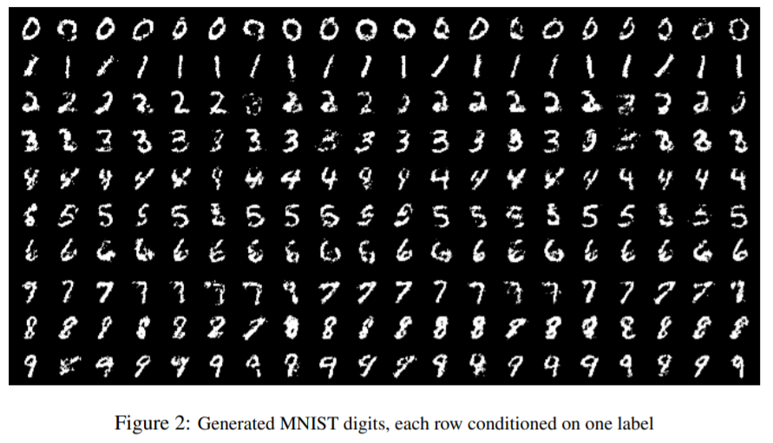
Conditional GANs
Forces G to generate with a specific class/feature
Reduces mode collapse during G’s training
M. Mirza and S. Osindero, “Conditional Generative Adversarial Nets,” 2014.
Notes:
Josh

Slide 7
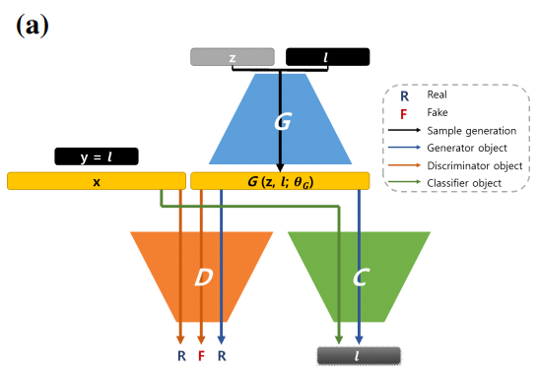
Controllable GANs
One major flaw with conditional GANs is that G can’t generate data with very rare features - D is much more likely to mark data with such features as fake
Ex: If the vast majority of wolf pictures are on snow, any generated pictures of wolves on grass are more likely to be marked as fake.
Controllable GANs include a separate classifier. G attempts to both fool D and be classified correctly by the classifier.
M. Lee and J. Seok, “Controllable Generative Adversarial Network”
Notes:
Alek

Slide 8
Explicitly Controllable GANs
An explicitly controllable G takes a vector for each desired controllable feature (age, pose, lighting, etc)
Encoders are used to transform human-readable input data into the vector format which G uses
An explicitly controllable GAN can create images without being constrained by the number of classifications
Ex: A controllable or conditional GAN might only be able to generate faces which would be classified as “old,” but an explicitly controllable GAN would be able to generate a face with a specific age.
Notes:
Alek

Slide 9
Pytorch Blitz
Notes:
Ryan

Slide 10
Tensors
Data structure designed to be used efficiently with GPUs and TPUs
Encode the input/output of data
Can be initialized:
Directly from data
From a NumPy array
From another tensor
With random or constant variables
Tensors contain information about what computations created them - the Computation Map
PyTorch, “Tensors”, https://pytorch.org/tutorials/beginner/basics/tensorqs_tutorial.html
Notes:
Ryan

Slide 11
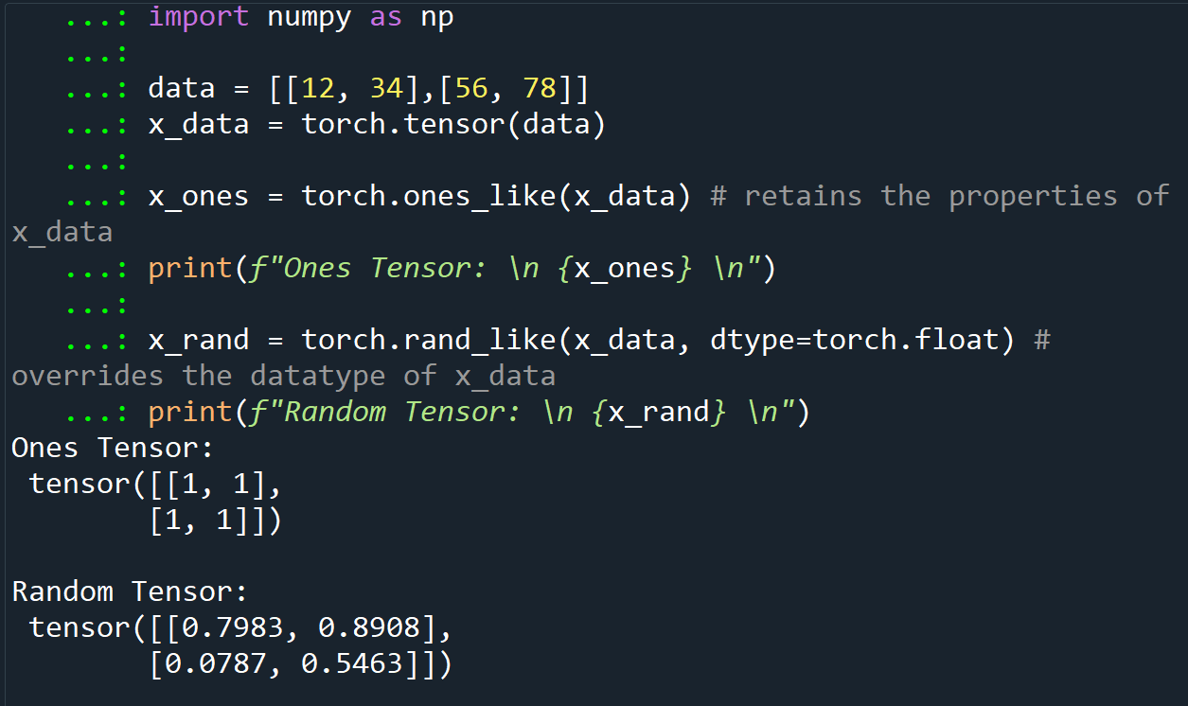
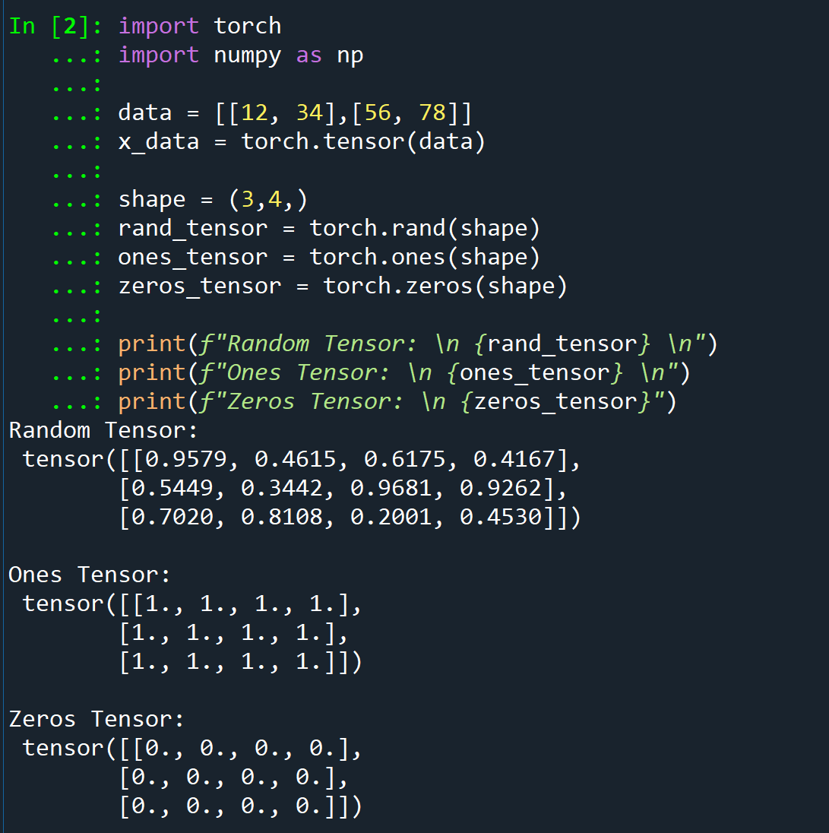
Tensors
Notes:
Ryan

Slide 12
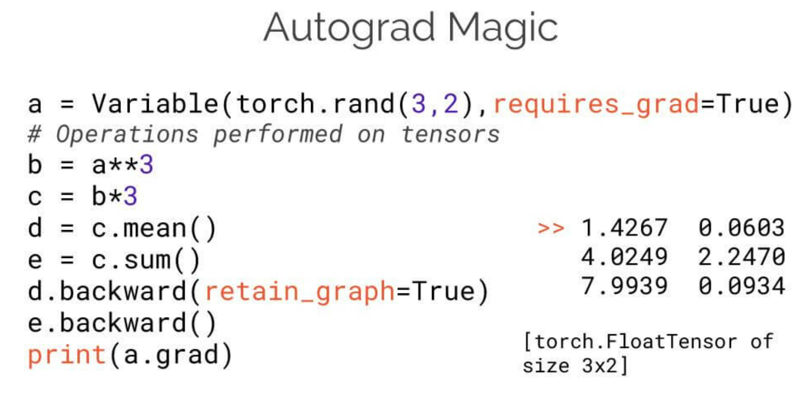
torch.autograd
Helps a neural network train
Tracks data (tensors) in a directed graph consisting of Function objects
Involved in forward and backward passes
PyTorch, “A Gentle Introduction to torch.autograd”, https://pytorch.org/tutorials/beginner/blitz/autograd_tutorial.html#sphx-glr-beginner-blitz-autograd-tutorial-py
https://info.algorithmia.com/test-import-blog/exploring-the-deep-learning-framework-pytorch
Notes:
Kyle

Slide 13
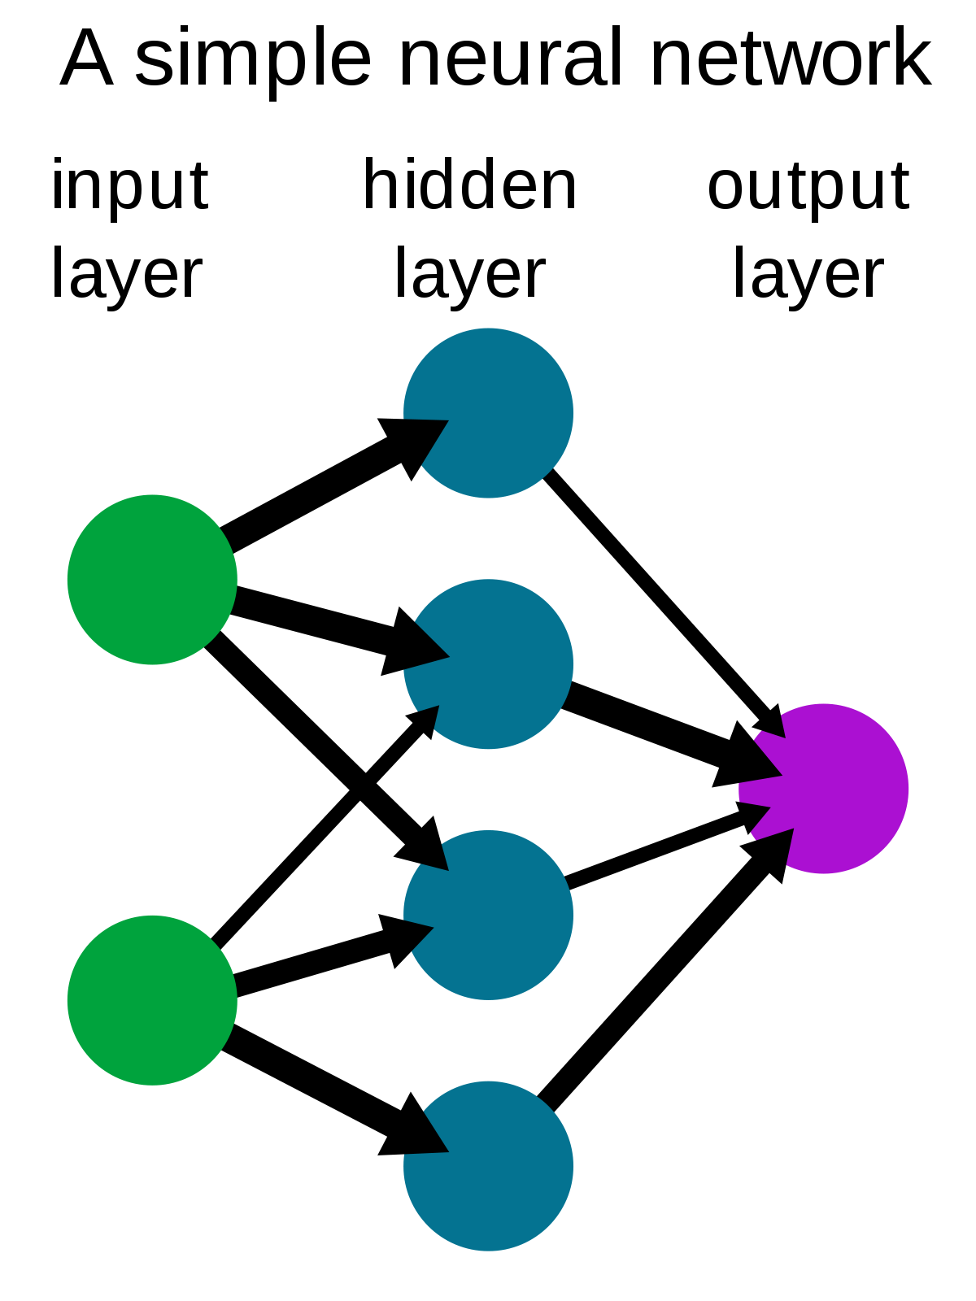
Neural Networks
Neural Networks (NNs) are nested functions that get executed on data input
Defined in parameters (weights and biases) which are stored in tensors
Training a Neural Network happens in two steps:
Forward Propagation
Backward Propagation
https://en.wikipedia.org/wiki/Neural_network
PyTorch, “Neural Networks”, https://pytorch.org/tutorials/beginner/blitz/autograd_tutorial.html#sphx-glr-beginner-blitz-autograd-tutorial-py
Notes:
Kyle
Forward Propagation - NN makes educated guess about the correct input
Backward Propagation - NN adjusts parameters in proportion to the error in its guess
Traverses backwards from output
Collects derivatives of the error with respect to parameters (gradients)
Optimizes the parameters using gradient descent

Slide 14
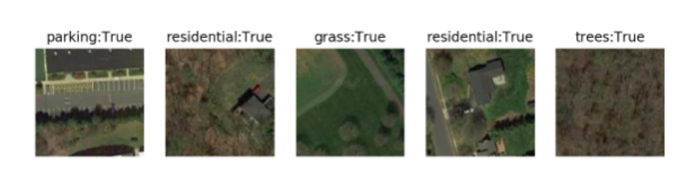
Training a Classifier
Load and normalize particular datasets with torchvision
Define a Neural Network (CNN, RNN, etc.)
Define a loss function
Train the network on training data
Test the network on testing data
PyTorch, “Training a Classifier”, https://pytorch.org/tutorials/beginner/blitz/cifar10_tutorial.html#sphx-glr-beginner-blitz-cifar10-tutorial-py
Notes:
Kyle

Slide 15
Conventional and Dynamic GAN Training
Notes:
Kyle

Slide 16
Conventional GAN Training
Alternate training by freezing each machine for a static number of epochs
5/2 Training Ratio
Discriminator
Generator
Discriminator
Generator
Discriminator
...
Trains
Trains
Trains
Trains
Trains
5 Epochs
2 Epochs
5 Epochs
2 Epochs
5 Epochs
[1] Lim et al. “Geometric GAN”
[2] Lin, Muyang et. al “GAN Compression: Efficient Architectures for Interactive Conditional GANs”
[3] Lei, Kai et. al “GCN-GAN: A Non-linear Temporal Link Prediction Model for Weighted Dynamic Networks”
[4] Lee, Hyeungill et. al “Generative Adversarial Trainer: Defense to Adversarial Perturbations with GAN”
[5] Mescheder, Lars et. al “Which Training Methods for GANs do actually Converge?”
[6] Gao, Lianli et. al “Lightweight dynamic conditional GAN with pyramid attention for text-to-image synthesis”
[7] Mirza Mehdi, “Conditional Generative Adversarial Nets”
[8] Lee, Minhyeok et. al, “Controllable Generative Adversarial Network”
[9] Goodfellow et. al, “Generative Adversarial Nets”
[10] Shoshan et. al , “GAN-Control: Explicitly Controllable GANs”
Notes:
Kyle

Slide 17
Conventional GAN Training
Original Motivation
Flaws
Stable training is an open problem
Alternates training
Simple to implement
Involves only 2 hyper-parameters
Ensures D is always better than G
D can be overtrained
Leads to inefficient computation
Minority of epochs spent training G
Doesn’t maintain a sense of fair competition between machines
Notes:
Kyle

Slide 18
Proposed Method: Dynamic Training
Phase 1: Conventional training for first T epochs
D
G
D
G
D
G
...
Phase 2: Train D until model yields minimum recall R
...
D
...
Phase 3: Switch which machine to train based on fpR w.r.t PL/PU
G
D
G
D
G
...
Notes:
Alek

Slide 19
Proposed Method: Dynamic Training
Assumptions:
Similar runtimes for training
Limited time or resources
No known “good” epoch ratio
Real data has some diversity
D can achieve a high recall
Additional hyperparameters:
Phase 1 length, T ∈ ℕ
Recall threshold, R ∈ (0, 1)
Push Threshold, PU ∈ (0, 1)
Pull Threshold, PL ∈ (0, 1)
D training interval
G training interval
G(z) at an epoch
False Positive Rate of D(G(z)) During Phase 3 Training
1.00
PU
fpR
Pull/Push Margin
PL
0
Epoch
Notes:
Alek

Slide 20
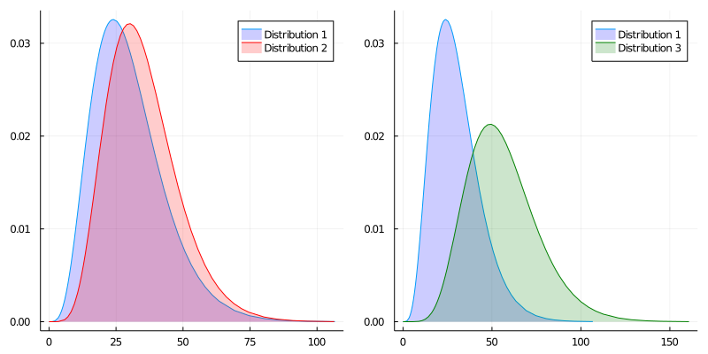
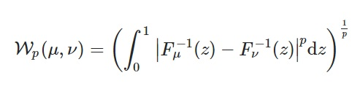
Measuring Convergence: Wasserstein Distance
Metric for dissimilarity between two 1-D probability distributions
Range: [0,∞) fewer = more similar
Plots courtesy of Medium.com “Entropy”
https://medium.com/analytics-vidhya/a-primer-of-entropy-information-and-kl-divergence-42290791398f
Notes:
Alek

Slide 21
Evaluating Convergence
What usually happens
What we want to happen
Wasserstein Distance
Wasserstein Distance
Training Time
Training Time
Modification of Figure by Walter Gerych
Notes:
Alek

Slide 22
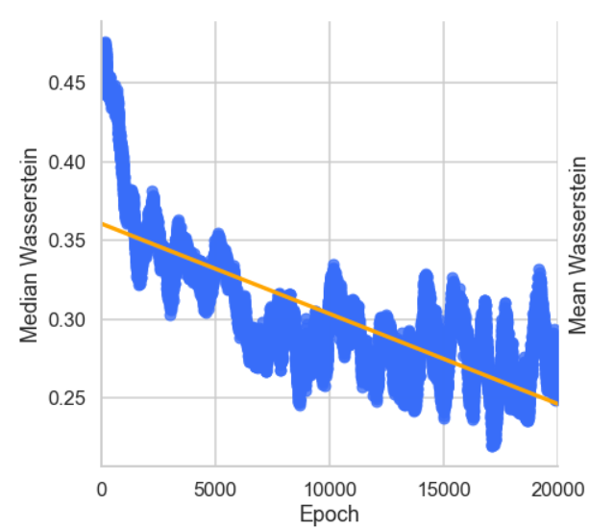
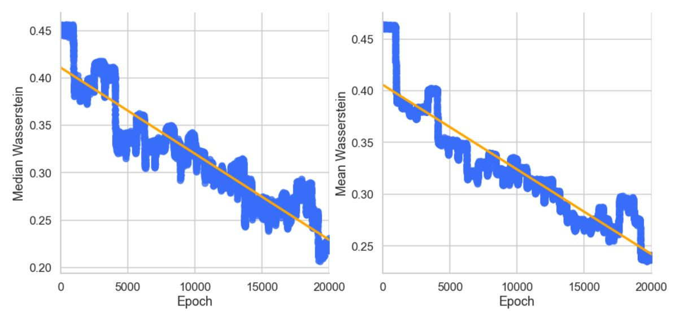
Prelim. Results: Median Wasserstein
Conventional Training
Dynamic Training
Notes:
Josh

Slide 23

Prelim. Results: Mean Wasserstein
Conventional Training
Dynamic Training
Notes:
Josh

Slide 24
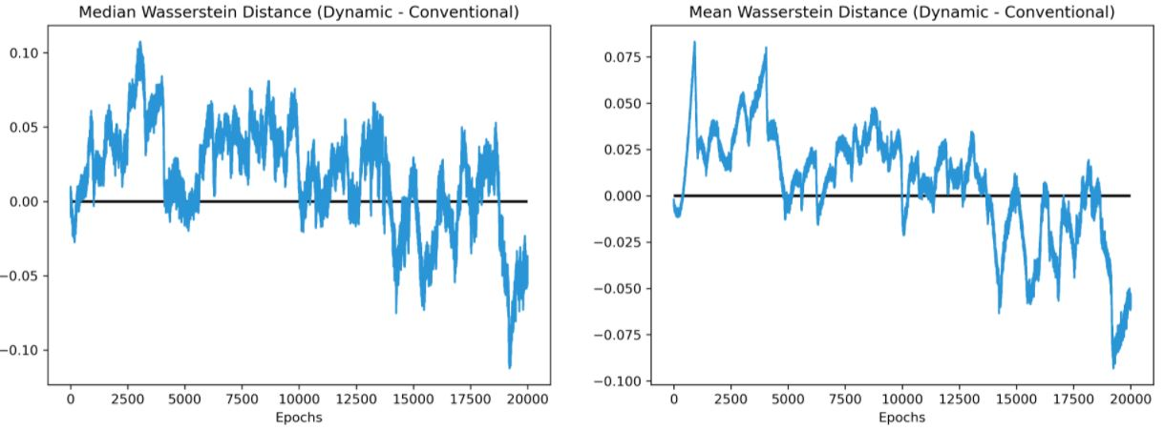
Prelim. Results: Wasserstein Difference
Negative means dynamic approach performed better that epoch
Notes:
Josh

Slide 25

Training Demo
Notes:
Josh

Slide 26
How Does This Add Value?
Improves training stability
Less variance in loss
Reduces frequency of redundant/inefficient epochs
Only trains a machine to stay competitive with adversary
Negligibly additional complexity for implementing
O(n) complexity w.r.t. volume of real data
Maximizes training of G
Doesn’t need to adhere to an epoch ratio > 1
Leads to equal to or quicker convergence (empirically)
Notes:
Josh

Slide 27
What’s Left?
Extensive set of experiments on multiple GAN architectures
Generalization of code to work for other architectures
Creating a usable PyTorch package
Theoretical analysis of method
Improvements to method
Other new training strategies
Notes:
Alek

Slide 28
Next Steps
Finish training listed on the GitHub
Implement a simple GAN
Understand other types of GANs
Explore other novel training strategies to experiment
Notes:
Kyle

Slide 29
Takeaways
Pytorch and Anaconda are useful packages/tools
Simple GANs learn by competition
Dynamic training is a novel approach to limiting unstable training.
Dynamic training demonstrates some efficacy
Notes:
Ryan

